Slide 1

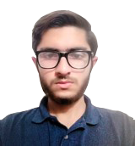
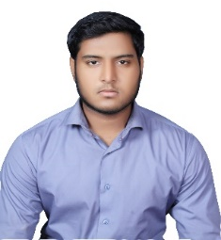
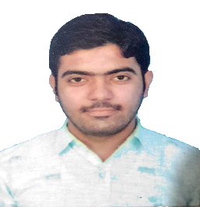
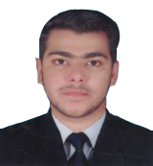
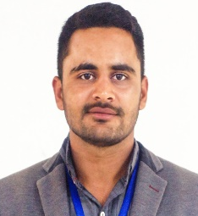

1. Insert your university logo here in High Definition HD (600dpi) only.
Align your logo with NPC logo such that the position of NPC logo may not be changed.
An IoT based MEMS Sensor to Detect Biomarkers in Exhaled Breath
Assadullah Shaikh*, Muhammad Khalid, Meer Hameer, S.M Hamza, Salman Khan
2. Write team members name with team lead marked by* (Without bold).
3. Change Dawood University of Engineering and Technology, Karachi to your university name. (In bold) .
Dawood University of Engineering and Technology, Karachi.
ABSTRACT
Internet of Things (IoT) and Micro Electro Mechanical System (MEMS) technology has played a major role in the advancement of smart health care and medical science. MEMS and microfluidics have provided the ability to integrate laboratory processes and biological analytes detection at micro scale. Micro sensors and actuators allow a MEMS device to sense, act and compute in a very short time. IoT enables to collect the information in real-time and send to the remote locations using IoT modules.
In this project, an IoT based MEMS sensor has been proposed to detect low concentration biomarkers from the exhaled breath. It is based on the Breath Analysis (BA) techniques used in medical science to detect infectious biomarkers exhaled in breath. An infected person exhales different kind of biomarkers which are sensitive to and detectable by biological analytes or polymers. This operation will be performed by MEMS device. IoT enables the data to be stored in cloud servers that can be securely accessed by the remote health care centers and received by doctors using IoT modules. The data is analyzed by doctors and based on their decision, a treatment regime could be advised.
NPC TEAM
4. Place passport size individual picture of Team in HD quality (600dpi) with transparent background.
Mr. S.M Hamza
(Member)
Mr. Muhammad Khalid
(Member)
Mr. Assadullah Shaikh
(Team Leader)
Mr. Meer Hameer
(Member)
Mr. Salman Khan
(Member)
NPC Team Details
NPC Category | Poster | NPC-ID
NPC Theme | Socially Beneficial | XX2056

